Slide 1

Modelling orbital decay of Hot Jupiters
Lawrence Berry
11/10/2023
[Nasa]

Slide 2
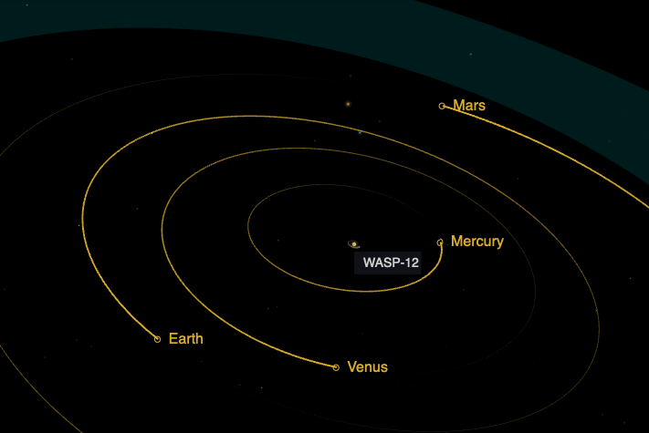
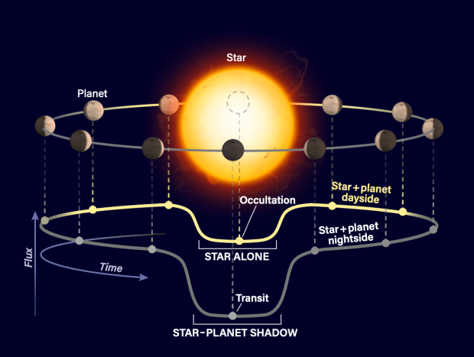
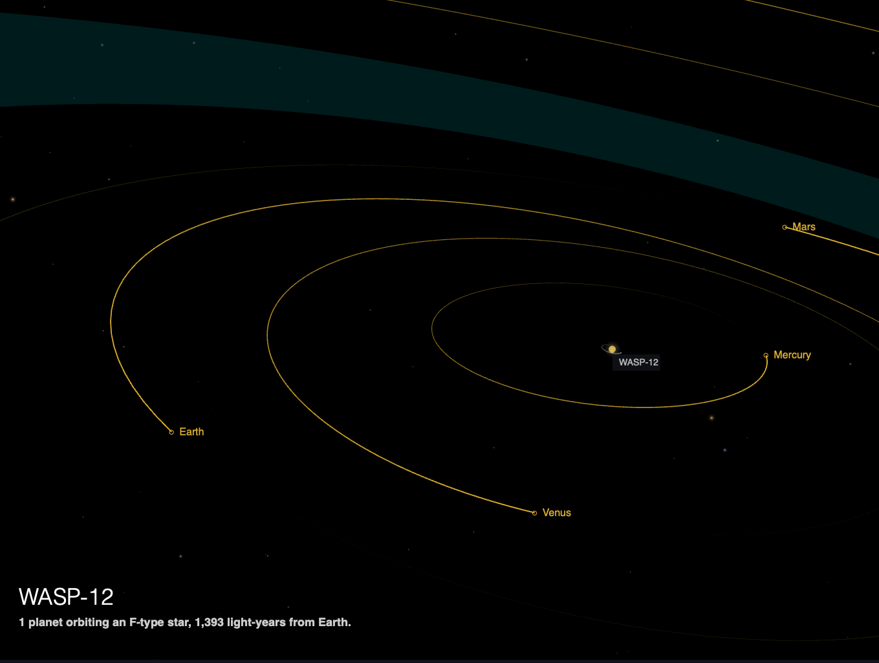
Introduction
[Nasa]
[Astronomy Magazine]
What are hot Jupiters?
What is the transit method?
What are transit timing variations?
Notes:
What are hot Jupiters? Big Jupiter sized gas giants orbiting very close to their host star. It’s still unclear how these could have formed so close to their star without their material getting sucked in as the star was born.
What is the transit method?
What are TTVs? Deviations of the midpoint transit time from what you would expect if this planet were orbiting in a perfect closed ellipse.
TTVs can be caused by several phenomena, but essentially points either to:
some kind of gravitational perturbation that means your potential is not exactly that of a two-body system (which would otherwise be a perfect closed ellipse) such as a moon or another planet
Oblateness (or quadrupole moments)
tidal influences which add or take away energy from the planet (primarily those raised by the planet on the star but potentially also star on planet or planet on planet)
apparent effects due to changes in geometrical projection (most obviously, parallax, but potentially also proper motion of the star)

Slide 3
Motivations + Goals
Motivations (why are TTVs interesting?):
TTVs can be a sign of orbital decay. Understanding how and why planets decay helps inform and test planetary formation theories.
Tidal decay is a consequence of stellar and planetary composition and structure. Decay rates could tell you something about the star and planet’s structure.
Goals of my project:
Identify hot Jupiters with statistically significant transit timing variations (TTVs).
Which are good candidates for follow up study
What are the physical causes of TTV in those systems
For those systems undergoing tidal decay, measure and classify the strength of tidal dissipation by stellar age and position on the main sequence.
Test and inform models of stellar structure
Notes:
What is tidal decay? The tides induced by the planet on the star cause the star’s rotation to speed up and the planet’s orbit to slow down
Akin to the moon speeding up

Slide 4
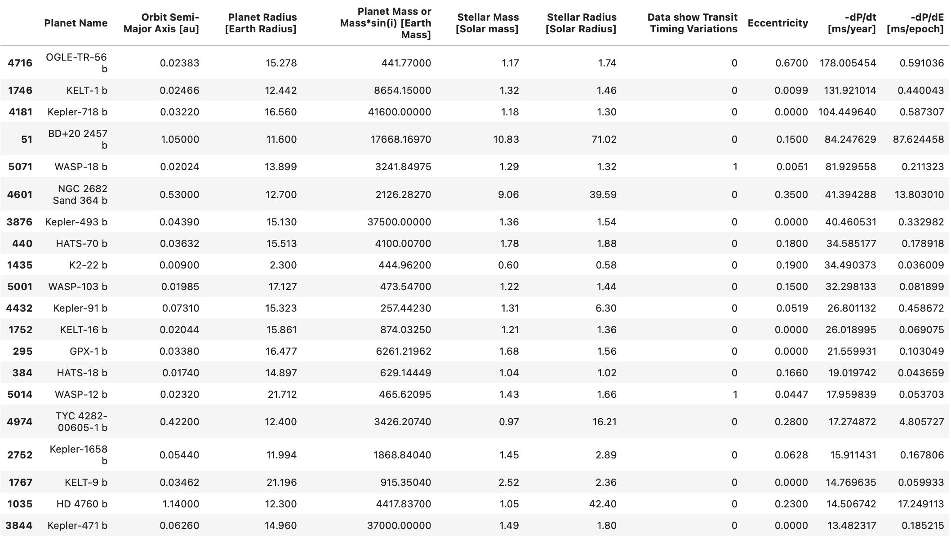
Last time
Used tidal decay theory to rank planets by predicted orbital decay rate
Fitted an orbital decay model to TESS light-curve data for WASP-12b
The fitted decay rate was similar to the predicted!
(0.08 vs 0.05 ms/epoch)

Slide 5
This time…
I’m going to focus on the observations and try and fit decay rates for many planets.
Most importantly, I’m also going to infer the uncertainty in fitted decay rates.
We need this if we want to make some assessment of statistical significance
Last time I used light curves and fit my own transits, but to save time I’ve assembled a dataset of already-fitted transits:
Exoplanet Transit Database
ExoClock
Kepler/TESS
My own measurements?
Built a rigorous statistical pipeline for modelling decay rates en masse.

Slide 6
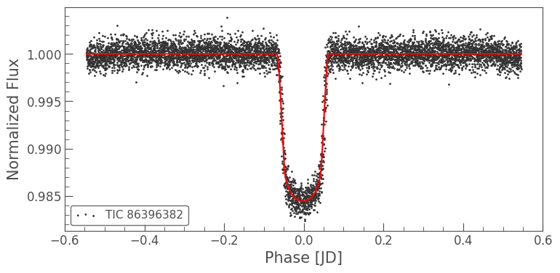
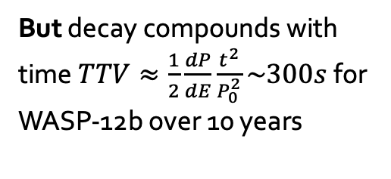
Why is this a hard problem?
Uncertainty in the transit time measurements is large
Fundamental lower limit ~ sampling rate
Even if you could measure individual photons there’s a lower limit described by photon statistics! ^{[Holman & Murray, 2004]}
Lots of amateur data
Fitted with different modelling pipelines
Reported uncertainties may be optimistic
Some observations may not even be real transits!
Often of the same order as the timing variation we’re trying to measure
Easier for orbital decay
Longer baseline = larger timing variation
Change in period per time isn’t even linear
We’re talking about things that vary milliseconds per epoch and this scale is in days!
But decay compounds with time$TTV≈\frac{1}{2}\frac{dP}{dE}\frac{t^{2}}{P_{0}^{2}}\sim 300s$ for WASP-12b over 10 years
Notes:
Most Tess cadences are 2 minutes, I think some 20s going forward and full frame images every 30 minutes.
This is a bit of an exaggeration. In fact, because decay per epoch compounds over time. Theory suggests that decay is roughly constant per orbit. As the planet decays it undergoes more orbits per year, so the decay per time goes up.
After 10 years we’re talking about a total transit time variation of more like 300s for WASP-12b.

Slide 7
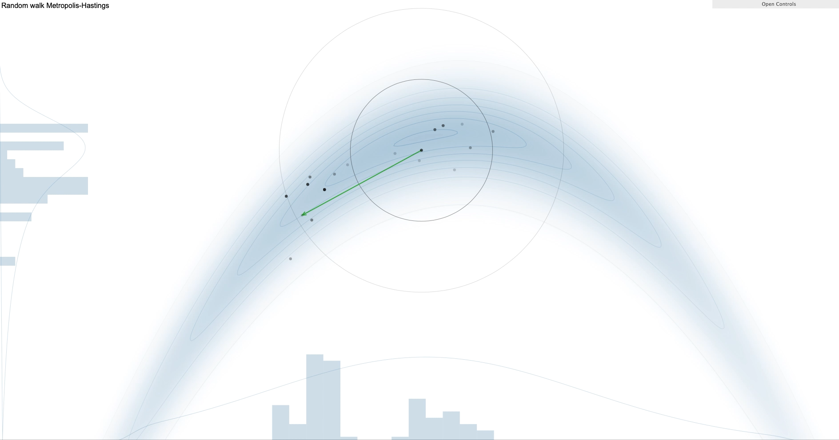
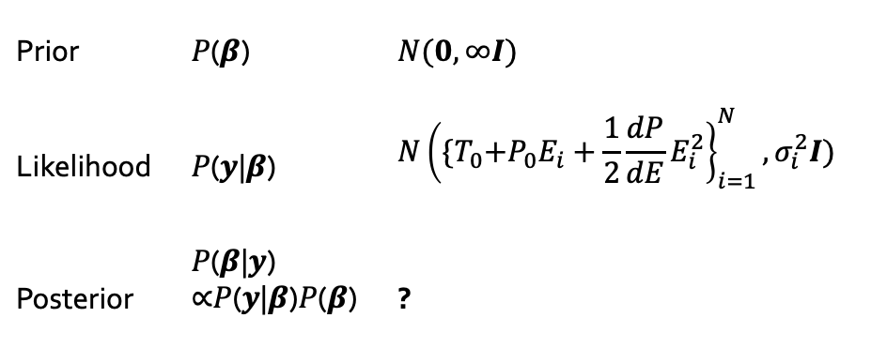
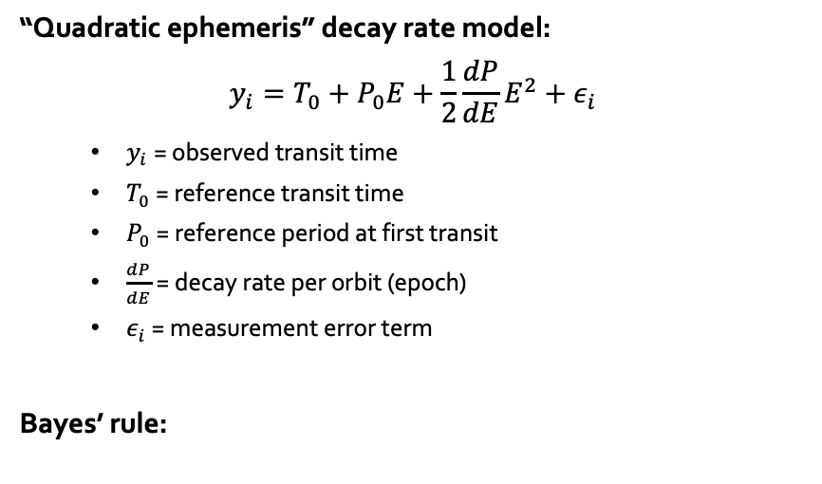
Recap: Bayesian statistics + MCMC
“Quadratic ephemeris” decay rate model:
$$y_{i}=T_{0}+P_{0}E+\frac{1}{2}\frac{dP}{dE}E^{2}+ε_{i}$$
$y_{i}$ = observed transit time
$T_{0}$ = reference transit time
$P_{0}$ = reference period at first transit
$\frac{dP}{dE}$ = decay rate per orbit (epoch)
$ε_{i}$ = measurement error term
Bayes’ rule:
Prior | 𝑃(𝜷) | $$N(0,∞I)$$
Likelihood | 𝑃(𝒚|𝜷) | $$N{\left({\{T}_{0}+P_{0}E_{i}+\frac{1}{2}\frac{dP}{dE}E_{i}^{2}\right\}}_{i=1}^{N},σ_{i}^{2}I)$$
Posterior | 𝑃(𝜷|𝒚) ∝𝑃(𝒚|𝜷)𝑃(𝜷) | ?
Demo of an MCMC using Metropolis-Hastings sampling
Source: http://chi-feng.github.io/mcmc-demo/
Notes:
The demo shows a two dimensional parameter space i.e. beta is a vector of length 2.
The true posterior distribution is the arch shape, and the algorithm is figuring out new points at which to sample the space.

Slide 8
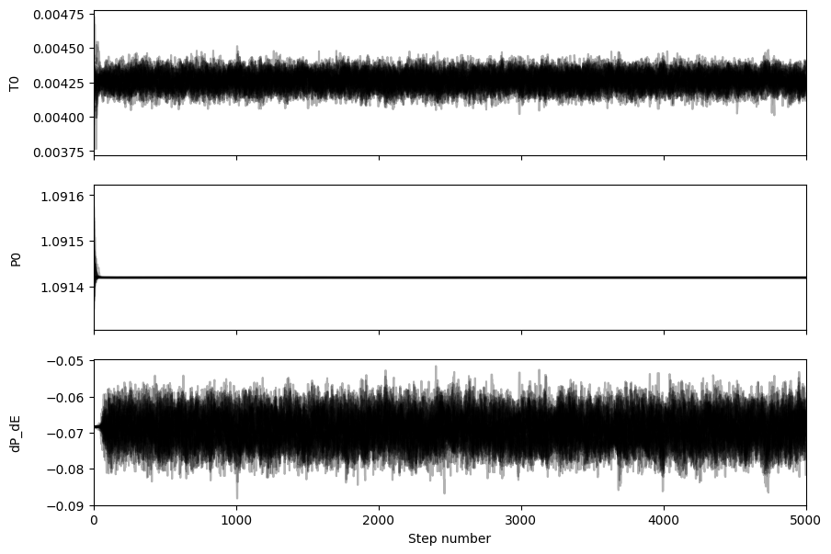
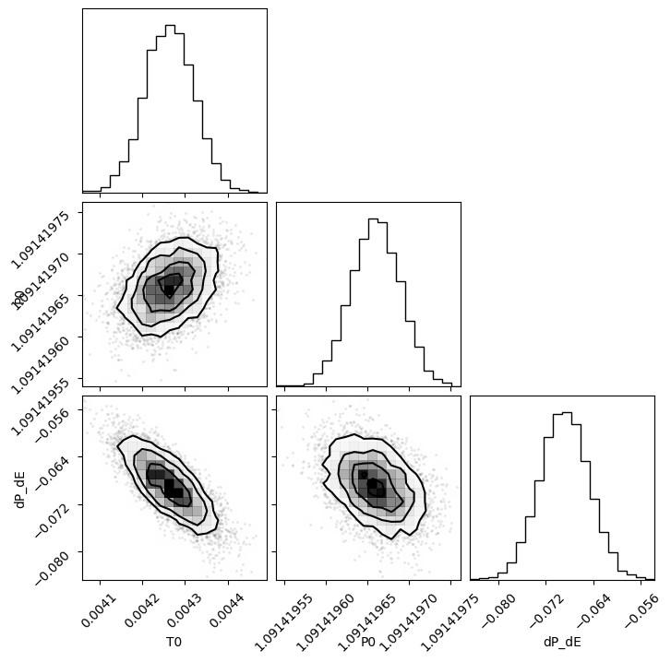
MCMC example: WASP-12b
Posterior distributions
Parameter samples

Slide 9
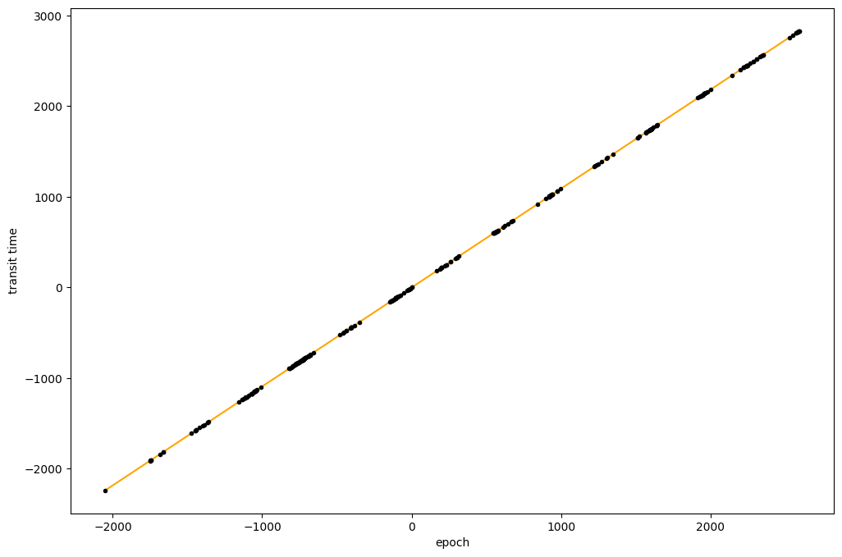
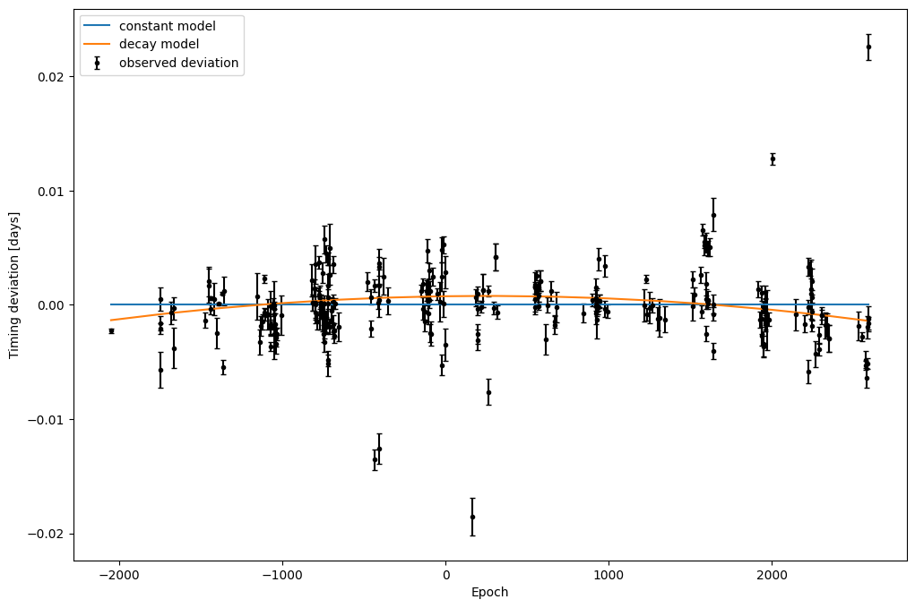
MCMC example: WASP-12b
Resulting model fit
It’s easier to see the non-linearity when we subtract a constant period model aka observed-computed aka TTV

Slide 10
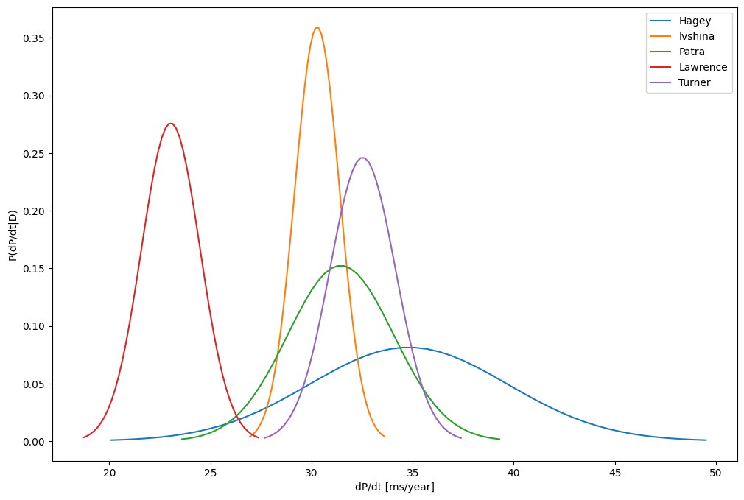
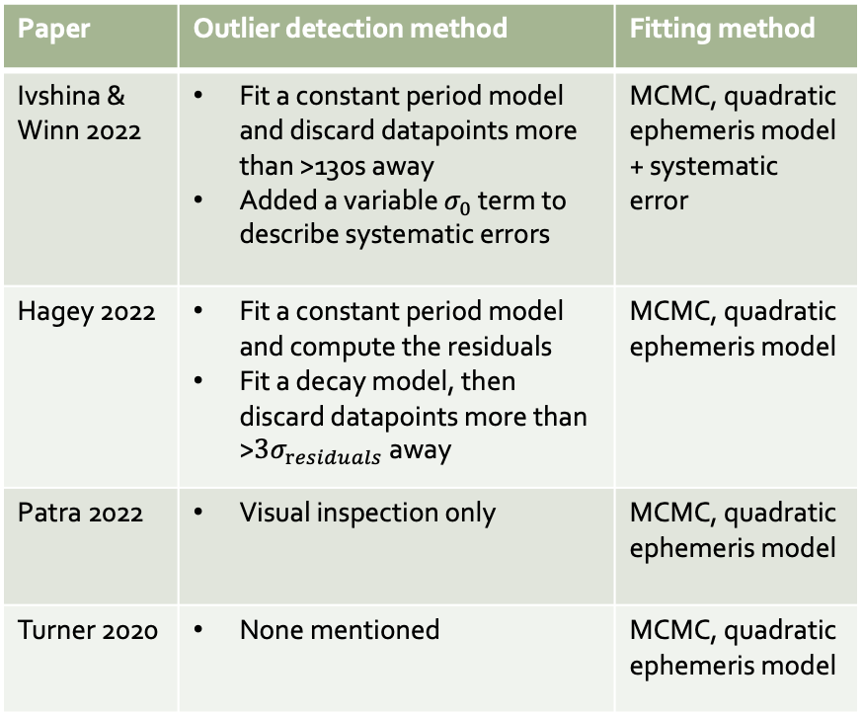
What have others done?
Paper | Outlier detection method | Fitting method
Ivshina & Winn 2022 | Fit a constant period model and discard datapoints more than >130s away Added a variable $σ_{0}$ term to describe systematic errors | MCMC, quadratic ephemeris model + systematic error
Hagey 2022 | Fit a constant period model and compute the residuals Fit a decay model, then discard datapoints more than >$3σ_{residuals}$ away | MCMC, quadratic ephemeris model
Patra 2022 | Visual inspection only | MCMC, quadratic ephemeris model
Turner 2020 | None mentioned | MCMC, quadratic ephemeris model
Fairly different results
🤔
Notes:
5 papers out there that have done a survey for statistically significant TTVs across multiple planets. Three of those actually calculated decay rates rather than just saying oh here is some statistically significant TTV.
I’ve added a fourth result representing the latest work on WASP-12b.

Slide 11
How can we improve this?
Problem | Solution
Choice of data affects results A larger dataset should only improve your uncertainty! In fact, if you know the measurement errors exactly, uncertainty only depends on the number of measurements you make. | Keep as much data as possible. Only exclude datapoints which aren’t real transits or are labelled with an incorrect epoch. Everything else contains information.
Parametric outlier detection can introduce a false signal But we still want to be able to exclude fake transits… | Non-parametric outlier detection.
Excluding data-points because they don’t agree with our physical assumptions results in a better fit Some transits aren’t fake but appear to be ”wrong” | If you have a strong belief in a particular class of models being correct, that view is better reflected as a prior, not by simply excluding them.
Reported measurement errors may be wrong Outlier detection is very binary - what if the datapoint does correctly identify a transit, but its reported error is inaccurate. A naïve model might exclude it for fear of putting too much weight on it in the resulting fit. In this case outlier detection is a bit of a blunt tool. | Instead, we should let the model learn what the true measurement uncertainties are.
Notes:
These papers raised a number of recurring issues.
Point 3: what we really mean when we say these datapoints look “wrong” is that their reported error is inaccurate.
Point 4: let the model learn what the true measurements are. If you have a stronger prior on a model, this should make you more likely to fit data by increasing error rather than adjusting parameters.
Filtering outliers using standard deviations away from a fitted orbital decay model is problematic, as it has the potential to induce a false signal in the data by removing any data-points that appear to strongly disagree with the quadratic decay fit.
Filtering according to standard deviations from a constant fit may be more appropriate. Hagey tried this approach to double check the quadratic period fit wasn't inducing a false signal and found that fits where the linear model was better (according to BIC) resulted in quadratic fits with a negligible decay term i.e. clipping according to the quadratic model did not induce a false decay signal in models whose linear fit was actually better according to BIC.
However, we could equally lose indicators of a quadratic trend if clipping outliers according to deviation from a linear fit.
I want to build an outlier detection method centred around two ideas:
1. Focusing on physical intuition as means of detecting outliers i.e. can we use theory to predict possible "reasonable" bounds for what the period and decay rate could be, and use these to inform our modelling. We shouldn't try to fit to something which is clearly physically impossible. (See the HAT-P-1 example below.) => **Priors: introduce priors on the decay rate and period that force the model into a physical range.**
2. We can't be sure that the $1\sigma$ uncertainty of transit times given by the observers is correct. There are myriad reasons this uncertainty could be inaccurate, from systematic bias to human error. We need a way to accomodate "flexible" uncertainties in our model. Rather than simply clipping out bad data, which is quite a blunt instrument, we should be able to "de-weight" data-points dynamically. => **Dynamic uncertainty: make the uncertainty per transit a parameter of the model which we fit. The uncertainty provided in the data becomes our prior on this parameterized uncertainty instead.**

Slide 12
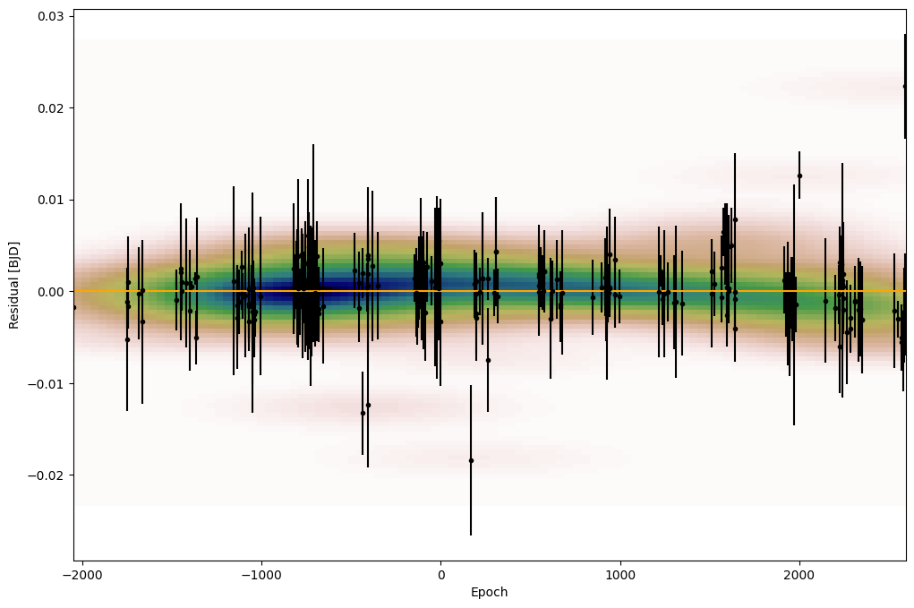
Non-parametric outlier detection
“Smudging” of datapoints produces an empirical probability distribution
Higher probability
Lower probability

Slide 13
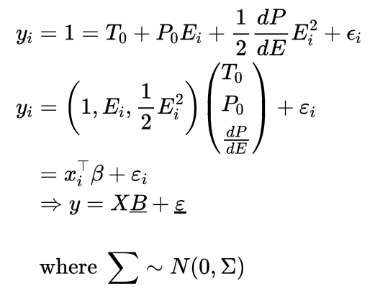
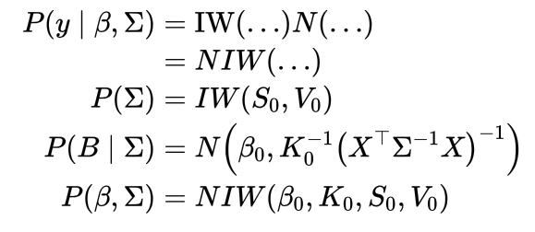
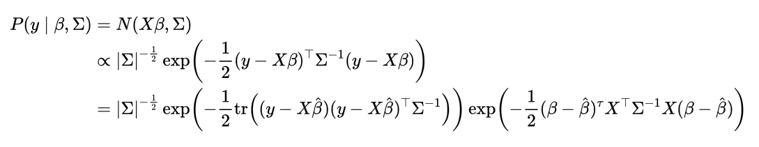
Bayesian multivariate regression
Rewrite the model as a linear regression:
Conjugate prior:
Errors are not necessarily IID!
Prior parameters
Controls our belief in the initial “prior” parameters
Likelihood becomes:
Reported measurement errors
Notes:
We note something pretty important, the model is linear in terms of its parameters! So we can just treat this as a Bayesian regression problem and the solution instantly becomes well-defined.

Slide 14
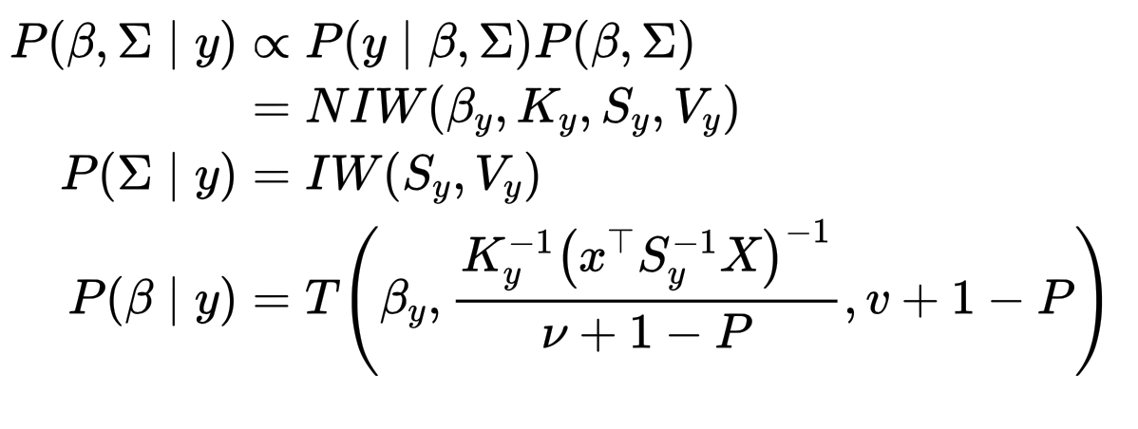
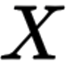
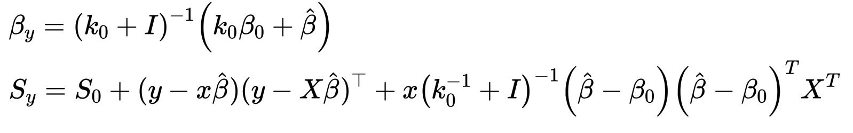
Bayesian multivariate regression: posterior
Uncertainty in the parameters is constrained by what we now think the measurement errors were
If we strongly believe the prior, we prefer to add error to the measurements to compensate for a bad fit
Reported errors
Empirical scatter matrix
Virtual scatter matrix

Slide 15



Some other issues with MCMC
The Bayesian model evidence describes the probability that the data was generated by your model (regardless of the values of the parameters of that model)

Slide 16
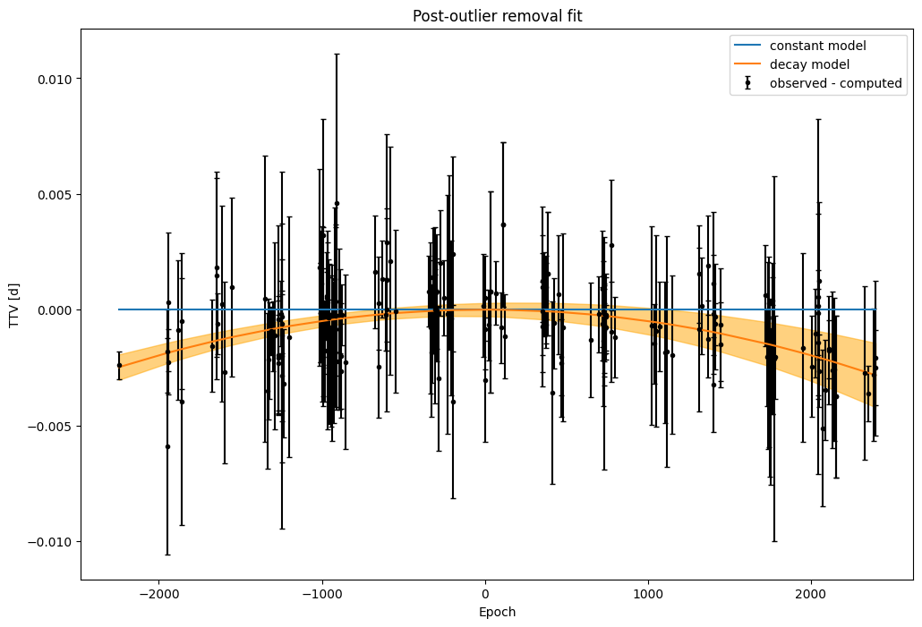
Bayesian multivariate regression: WASP-12b
3σ posterior model error
A curve fits better than a straight line!

Slide 17
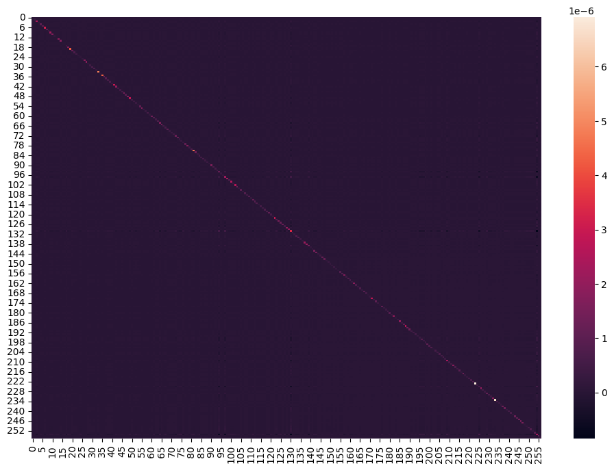
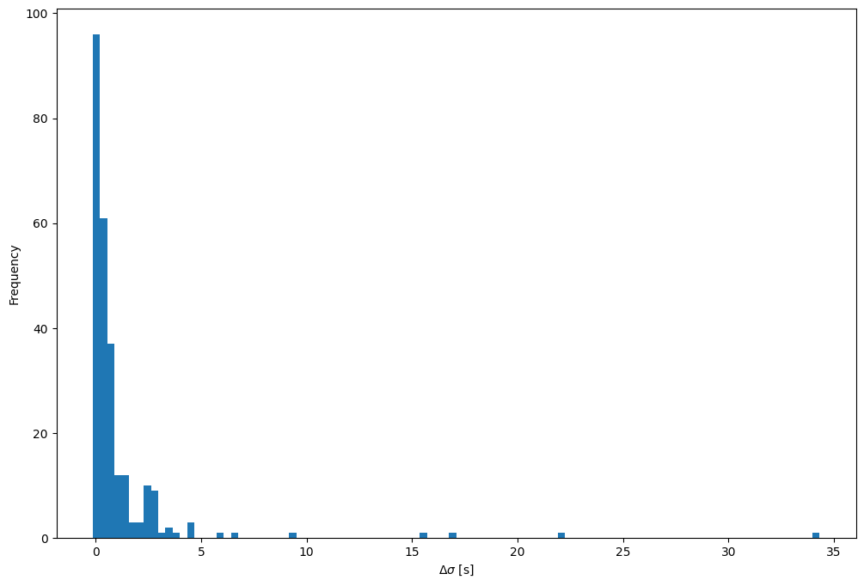
Bayesian multivariate regression: WASP-12b
What did we learn the measurement errors to be?
Measurements largely IID, no obvious systematic errors
Most stayed the same, some increased ~seconds
Notes:
The measurements appear to be IID, identically and independently distributed, great!

Slide 18
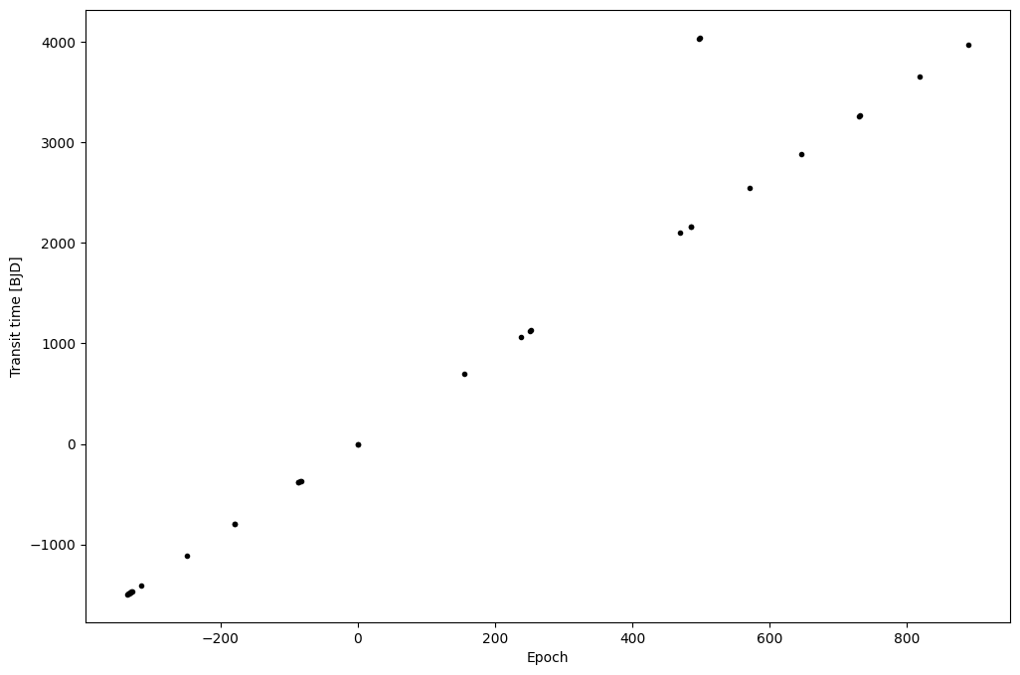
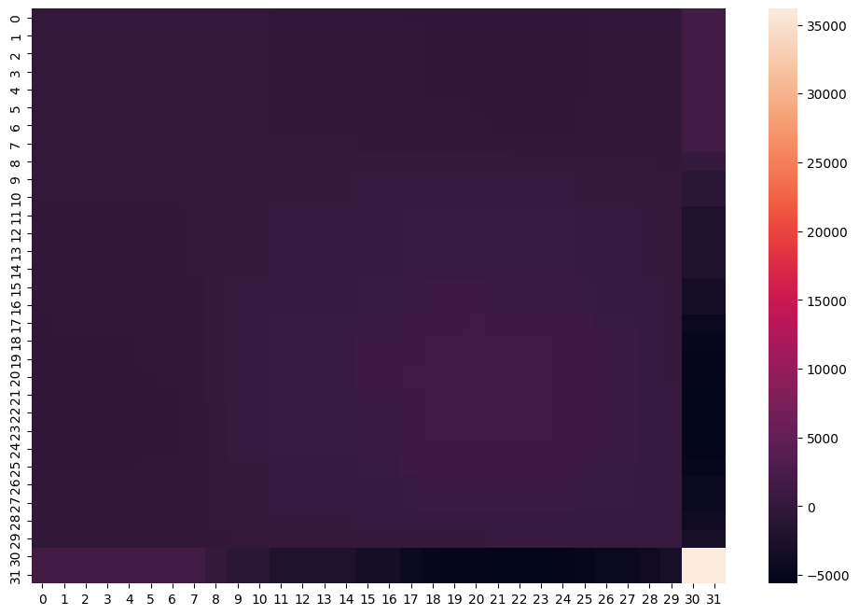
Bayesian multivariate regression: HAT-P-1
What did we learn the measurement errors to be?
This data has two obvious outliers
The model learns that these measurements have MUCH larger error than initially reported and identifies that they are covariant

Slide 19
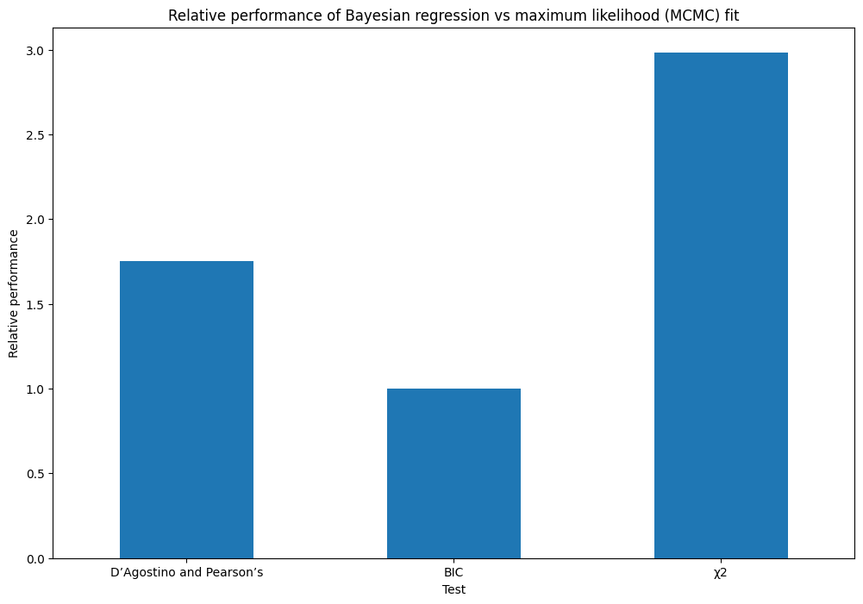
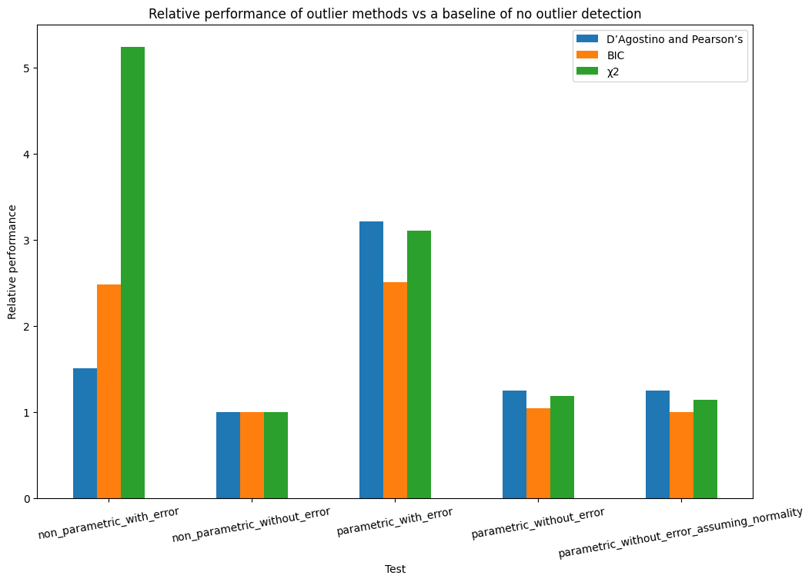
Comparison vs existing models
Bayesian multivariate regression wins in D’Agostino’s and χ², BIC similar despite the regression having MANY more parameters which BIC penalises
Non-parametric outlier detection works almost as well (if not better) than parametric outlier detection

Slide 20

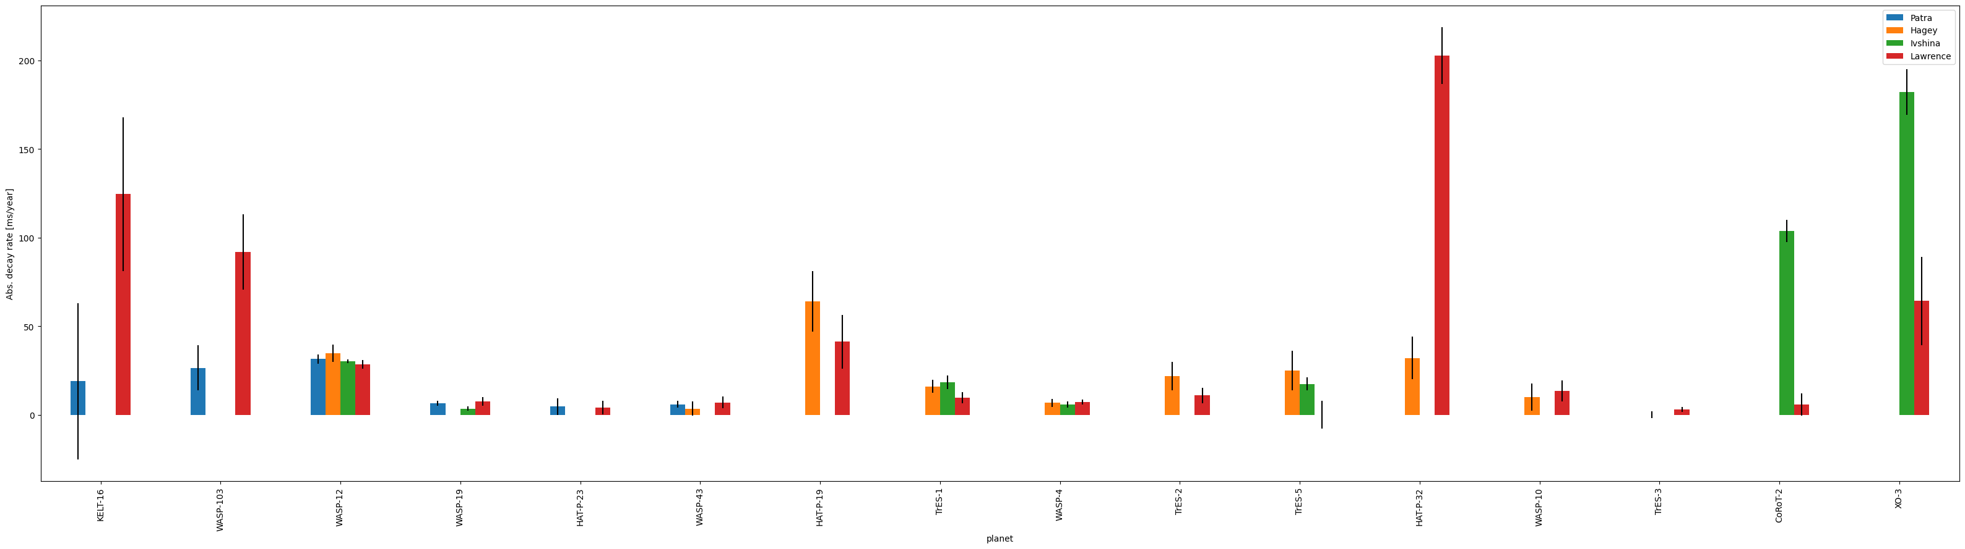
Results
[XKCD]
Notes:
Bit of an XKCD moment here
I think it would be naïve of me to say that my method is better and this should be the new standard, but I think it’s at least been an interesting exercise in pointing out some of the statistical inconsistencies that existing literature isn’t really considering.
And I now have a fitting method that is way faster and easier than MCMC so that’s nice too, no long sampling times, no more fiddling around with the chain length or the burn in time

Slide 21
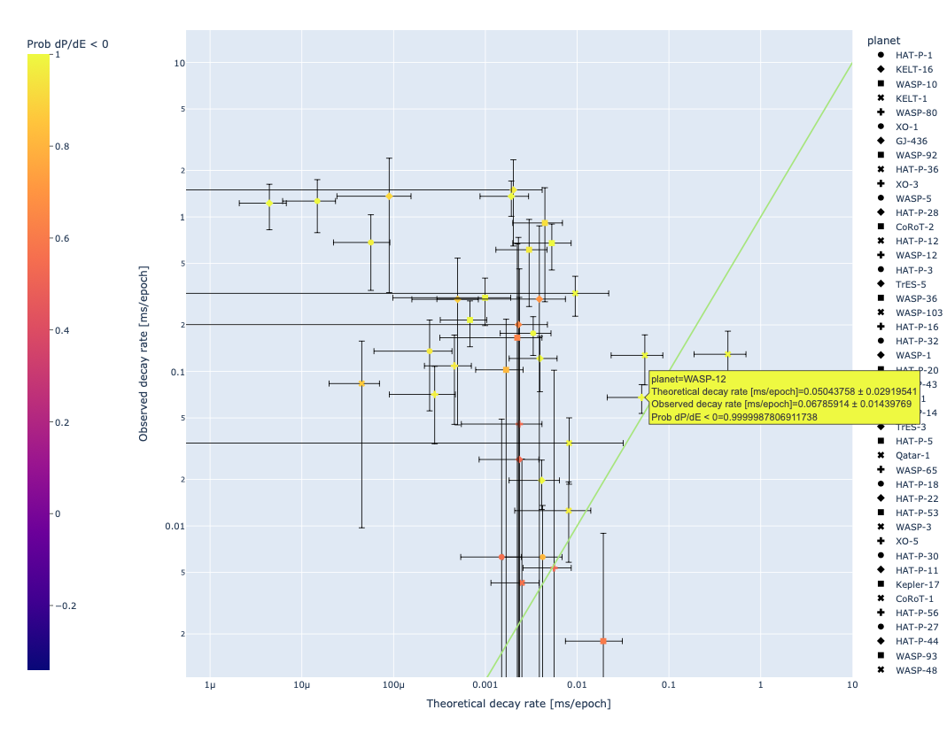
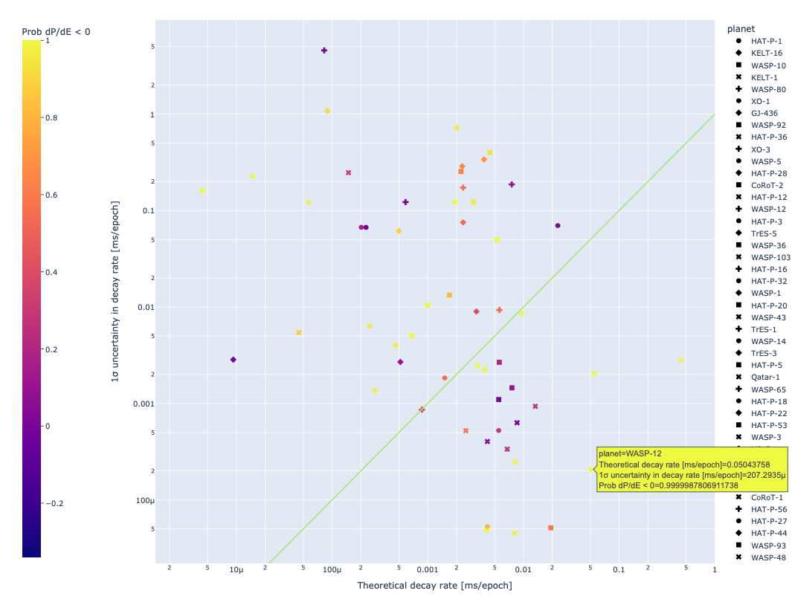
Observations vs theory
Observation ≠ theory
Perhaps something else is going on?
Uncertainty > theory
These planets need further observing
Observation ≃ theory AND observation ≫ 0
Good candidates for tidal decay
WASP-12, KELT-1, WASP-103

Slide 22
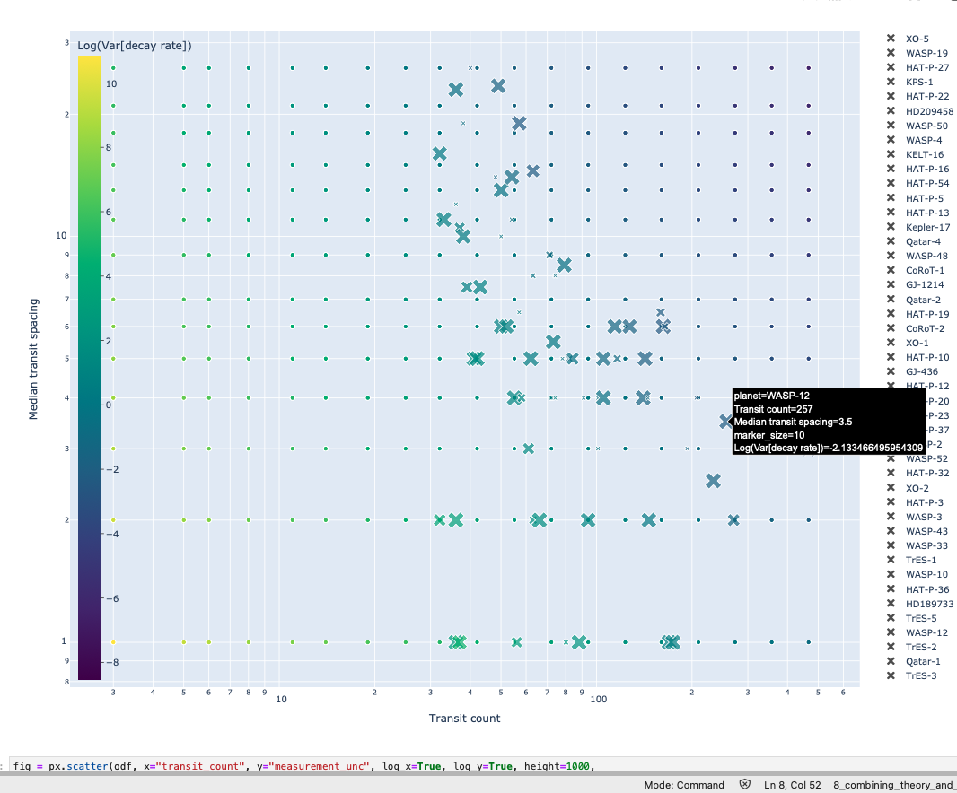
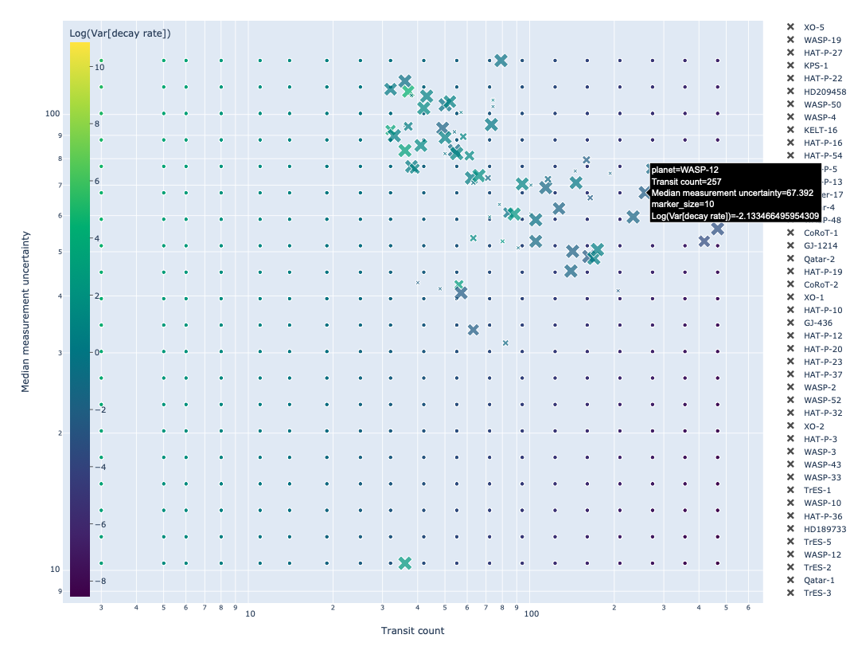
How can we improve uncertainty in decay rates?
Given a planet, we can say exactly how much a new measurement will reduce uncertainty in orbital decay. If you provide ”costs” and constraints of the use of various telescopes, we can construct an observational proposal which best reduces the uncertainty.

Slide 23
But is it tidal decay? + other future work…
”Theory” is very rough - Q* could be orders of magnitude different
Only fitted a decay model, perhaps we are missing out on other possible physical phenomena
e.g. we might be missing phenomena that would cause sinusoidal TTVs
Use normality tests to a constant period model to show statistically significant variation, then fit different models to decide what causes that variation
Apsidal precession
Inner companions perturbing the orbit
etc.
We can then compare those via the Bayesian model evidence 😃
For those systems whose best model is stellar tidal decay, let’s go one step further: fitting tidal dissipation factors and then classifying the strength of tidal dissipation by stellar parameters

